Slide 1

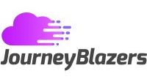
Marketing Analytics Project
Project Director: Celeste Johnson
Project Team: Brent Nakashima (lead), Barrett Acker, Aryan Baldua, Noah Pidding, Adam Kong

Slide 2
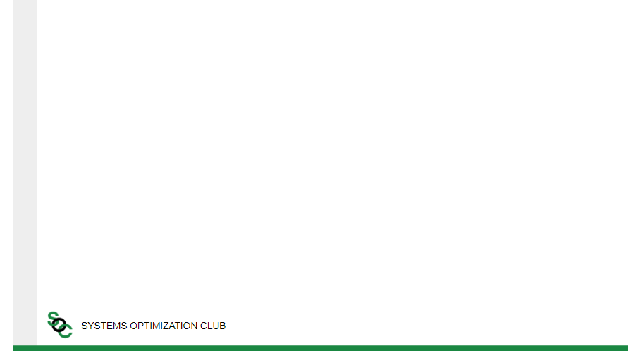

What is JourneyBlazers?
JourneyBlazers
Set up and customize Salesforce solutions for businesses
Overview
Founded in 2018
Based out of the East Coast
Founder and CEO - Gaurav Pawar
Notes:
Jen - cloud architect
Tim
Salesforce solutions - optimize processes and make data driven business decisions

Slide 3
Current State
Minimal resources
towards advertising
Low brand awareness among potential customers
Our task is to create and optimize advertisements
to help attract new clients
Notes:
Aryan Notes
JourneyBlazers currently faces a significant challenge due to the minimal resources allocated toward advertising. This lack of investment has directly resulted in low brand awareness among potential customers, limiting their ability to attract new clients and expand their reach

Slide 4


Methodology
01
Research
Media Platforms
Ad Types
02
Implement
Implement Ads to Platforms
03
Adapt
Case Studies
04
Collect
Collect Ad Performance
05
Conclude
Handoff

Slide 5
Audiences
Account Executives
Salesforce Employees
Leadership
Customer Relationships
Manages Salesforce Licenses
Decision making power
Crucial input for Salesforce Licenses
Promote JourneyBlazers to businesses and customers
Notes:
Account executives because they’re responsible for maintaining customer relationship and whether or not they buy new Salesforce Licenses or upgrade existing ones using Journey Blazers
Leadership because they had the executive and decision power and decide if they need Journey Blazers. They make all crucial decisions here with these licenses.
Last is SalesForce Employees, we planned to target them as those employees might promote JourneyBlazers services other businesses that need assistance with the SalesForce licenses.

Slide 6
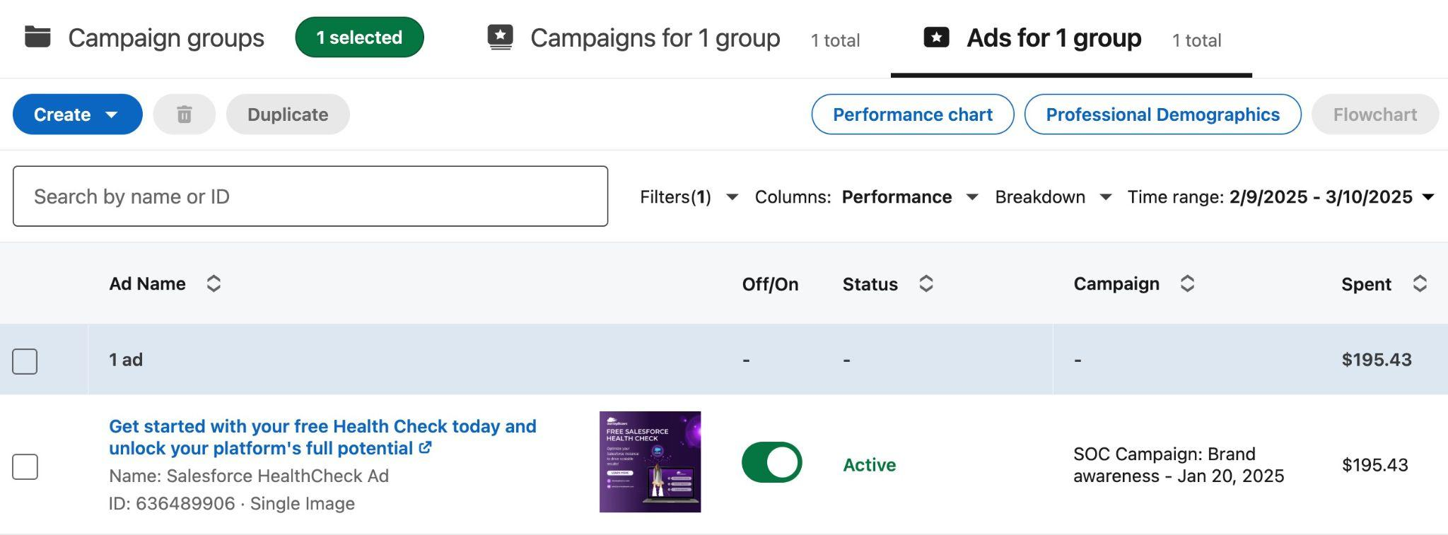
LinkedIn Ad

Slide 7
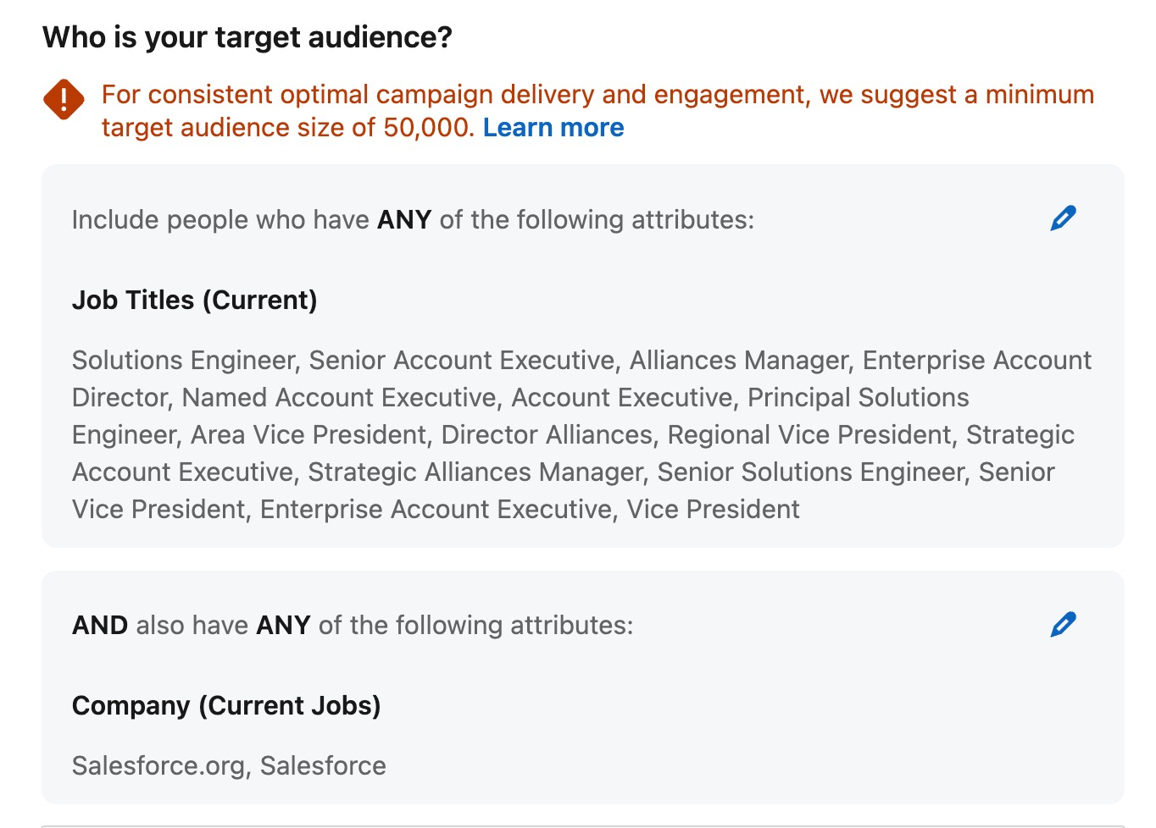
Target Audience

Slide 8
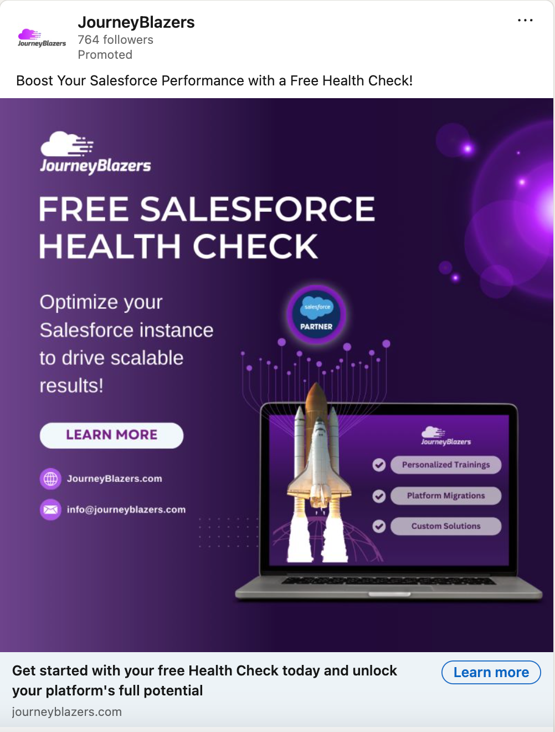
Final Deliverable
Header
Capture Attention
Inform
Build Credibility
Persuade
Tagline
CTA
Generate Leads
Notes:
Headline engages, captures attention
Tagline: inform, persuade, build credibility
CTA with contact info - generate leads
Signature jb purple for brand recognition/association

Slide 9
Case Study

Slide 10



Objective
Develop hands-on experience with data analytics tools
Answer analysis questions

Slide 11

Mock Apple Sales Dataset
Device Sales
Service Revenue
State | Region | iPhone Sales (in million units) | iPad Sales (in million units) | Mac Sales (in million units) | Wearables Sales (in million units) | Service Revenue (in billion $)
Chongqing | Greater China | 7.46 | 6.75 | 1.19 | 5.88 | 15.88
Germany | Europe | 8.63 | 14.06 | 7.03 | 7.42 | 10.12

Slide 12
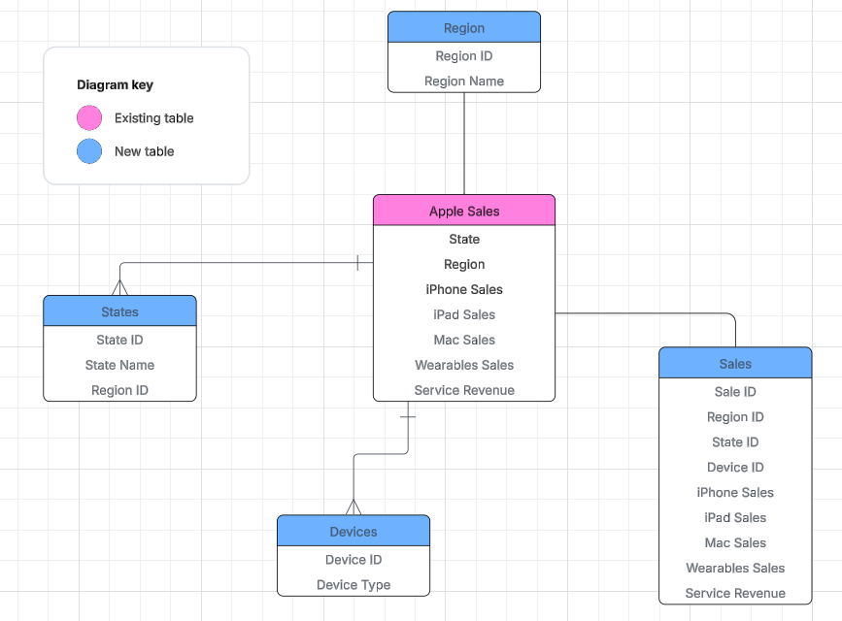
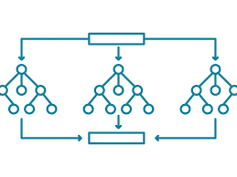
Key Takeaways
Data-Driven Analysis
Relational Databases
ML Model
Random Forest

Slide 13
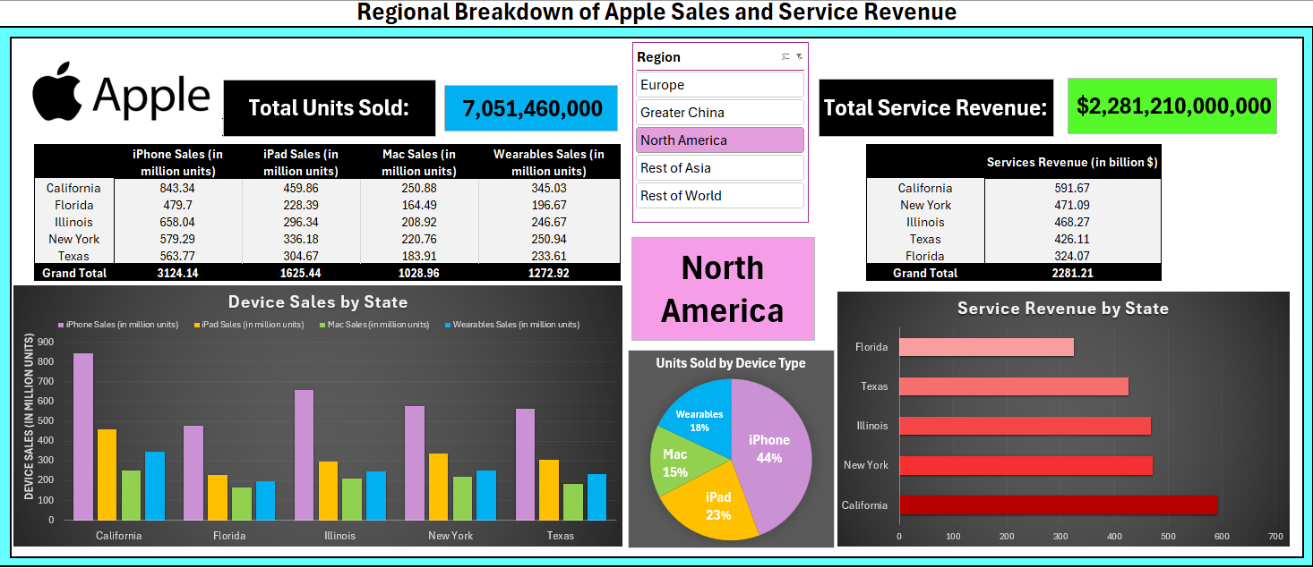
Interactive Dashboard

Slide 14
Case Study Takeaways
Better for larger data sets
Data extraction and querying
MySQL
Easy to use
Data organization and visualization
Excel
Predictive insights
Automate analytics
Python (ML)

Slide 15



Results
Design
Launch
Measure
Notes:
After the case studies/design process, we launched $500, month-long ad campaign 2 weeks ago. That being said, we are still waiting on the results so that we can use Looker studio to visualize effectiveness of campaign thru cost efficiency and conversion rates. However, because of communication issues on JourneyBlazers side which led to a delayed launch, we are unfortunately not going to get the chance to do so.

Slide 16
Future Direction
Continue the Campaign with Additional LinkedIn Ads
Expand Ad Platforms (Google Ads)
CI/CD for Looker Studio Dashboard

Slide 17
Key Takeaways
Notes:
Importance of adapting and adjusting on the fly
-htings dont go as planeed - shitfting priorities or unexpected challenges, key is to quickly access the situation, make adjustments, and keep moving forward

